Slide 1


Slide 2
Circular Queue
Presented by Dipesh Dhungana
Ace077bct035

Slide 3
Things to Discuss
Circular Queue
Algorithm
Source code in C language

Slide 4
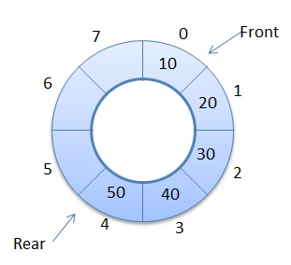
A Circular Queue is a special version of queue where the last element of the queue is connected to the first element of the queue forming a circle.
Queue Operations
Enqueue (Input)
Dequeue (Extract)

Slide 5
ENQUEUE ALGORITHM
Start
Check whether the queue is full or not as: if front==(rear+1)%maxsize print Queue is full and exit else rear=(rear+1)%maxsize
Queue[rear]=item;
Stop
Start
If(front==(rear+1)%maxsize) print "Queue Full”
Stop
Else rear=(rear+1)%maxsize Queue[rear]=item

Slide 6
DEQUEUE ALGORITHM
Start
Check whether the queue is empty or not as: if rear==front print Queue is empty and exit else front=(front+1)%maxsize
Item=Queue[front];
Stop
Start
If(rear==front) print "Queue is empty”
Else front=(front+1)%maxsize item=Queue[front]
Stop

Slide 7
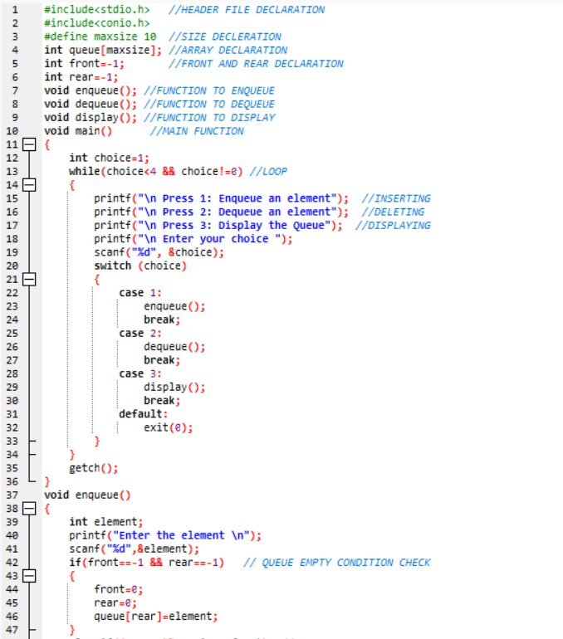
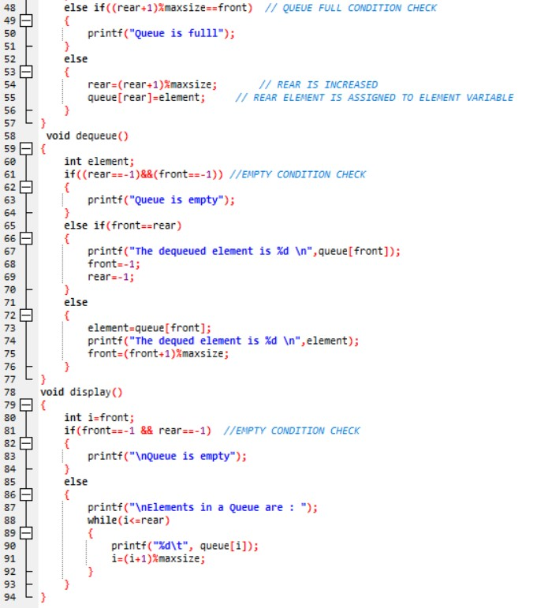

Slide 8



